Slide 1

Multimedia Analysis and Retrieval
https://github.com/jonhare/COMP3013-MIAR
Jonathon Hare
jsh2@ecs.soton.ac.uk
powered by

Slide 2
Contents
Why analyse multimedia?
How are images, videos and sounds represented in digital computers?
How do we extract information from multimedia?
An application – multimedia retrieval
Simple case: text retrieval
The multimedia retrieval pipeline
… with lots of demos and examples!!

Slide 3
Why analyse multimedia?

Slide 4
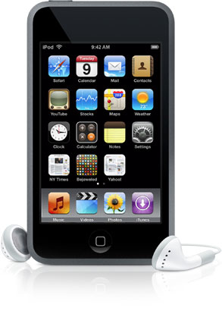
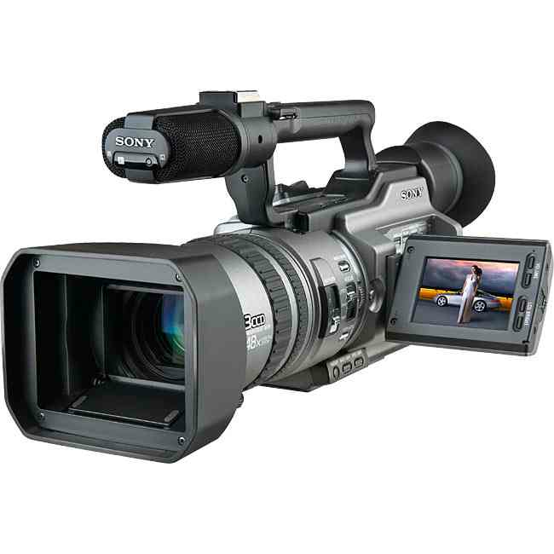
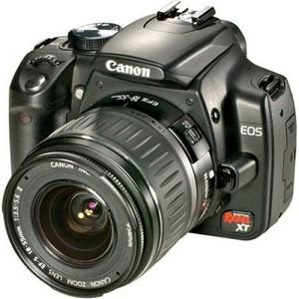



Multimedia is everywhere

Slide 5
Multimedia is everywhere
In 2012 flickr boasted hosting 7 Billion Photos

Slide 6
Multimedia is everywhere
Every minute 72 hours worth of video is uploaded to youtube

Slide 7
Multimedia is everywhere
As of October 2012 Spotify’s collection contains 18 million songs

Slide 8
Multimedia is everywhere
… that’s 170 years of music!

Slide 9
Analysis of this data can:
Help us find media that interests us
What sounds like this? Who looks like her? What is that?
Help us measure trends
What is popular now; what was popular then; what will be popular next?
Help us develop better compression techniques
…so we can store more data
Enable us to generate new media through re-composition
New artwork, augmented reality, virtual reality, …

Slide 10
Manual or Automatic?

Slide 11
Multimedia Representation

Slide 12

Digital Audio Representation
Digital sound is stored as a series of samples.
Each sample represents the loudness or sound pressure at an instance of time.

Slide 13
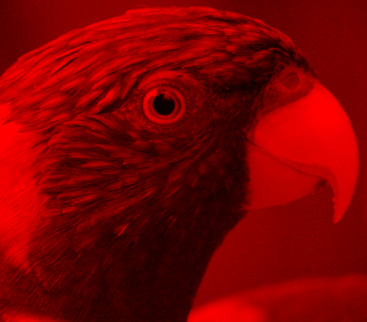
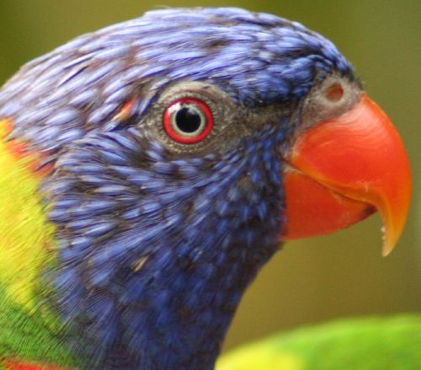
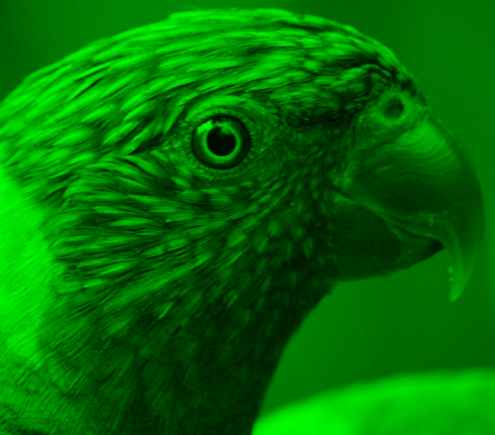
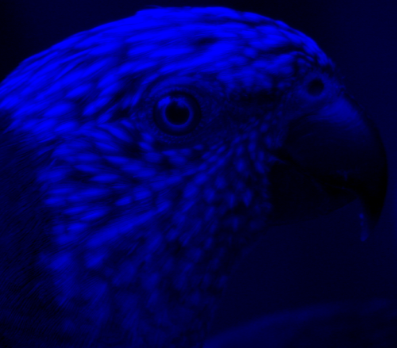
Digital Image Representation
87 91 85 ...
86 86 81 ...
88 85 84 ...
... ... ... ...
137 145 144 ...
153 150 137 ...
148 139 123 ...
... ... ... ...
89 91 89 ...
84 88 90 ...
88 87 90 ...
... ... ... ...

Slide 14






Digital Video Representation
Time

Slide 15
Multimedia Retrieval
Everyone of you is familiar with text retrieval
Google, Yahoo, Bing, …
Effective text retrieval has changed
…the way we work
…the way we learn
…the way we play
A current challenge is achieving effective retrieval of multimedia

Slide 16
What’s this music? Who performed it? When was it written?

Slide 17
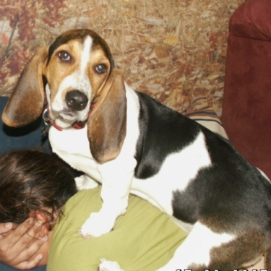
What is the name of this dog?

Slide 18






Slide 19
How does it work?

Slide 20
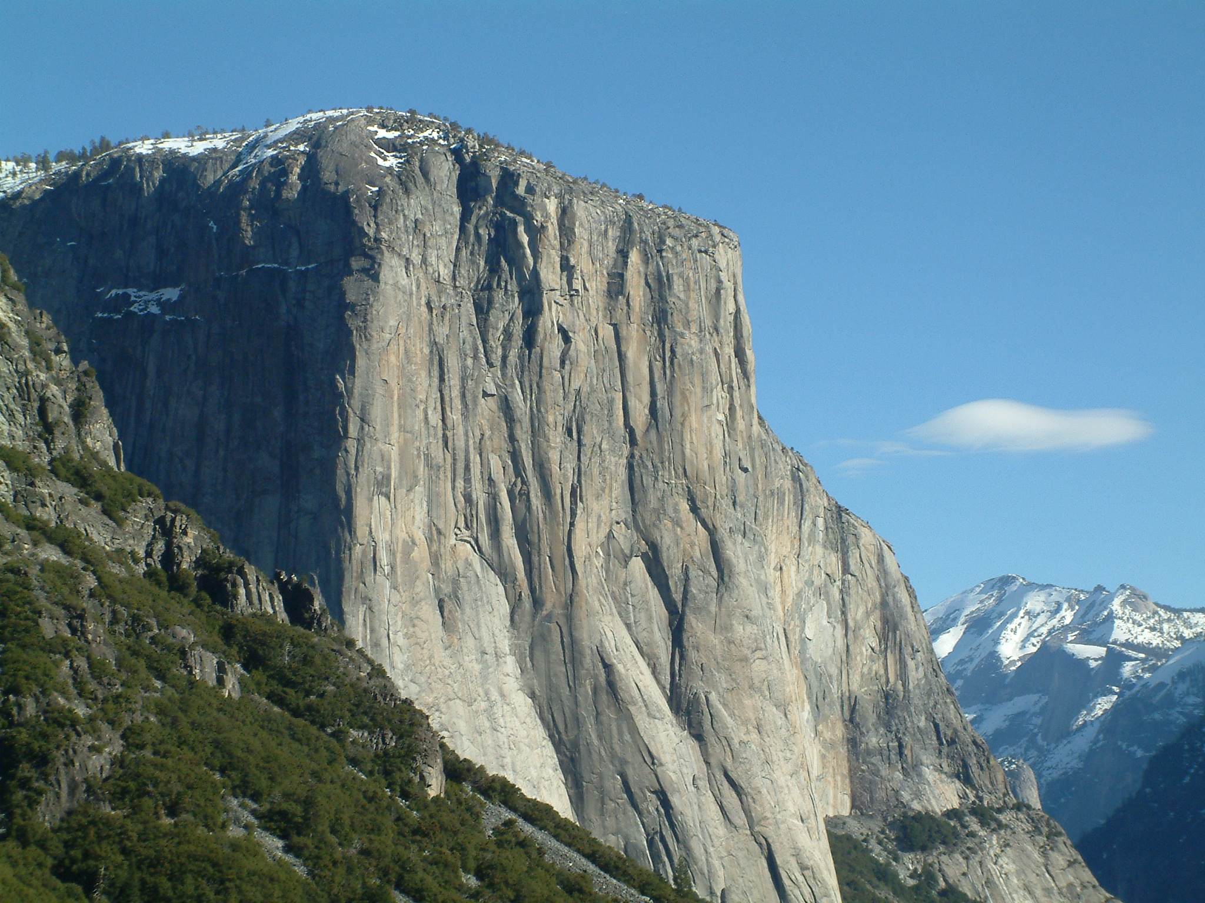
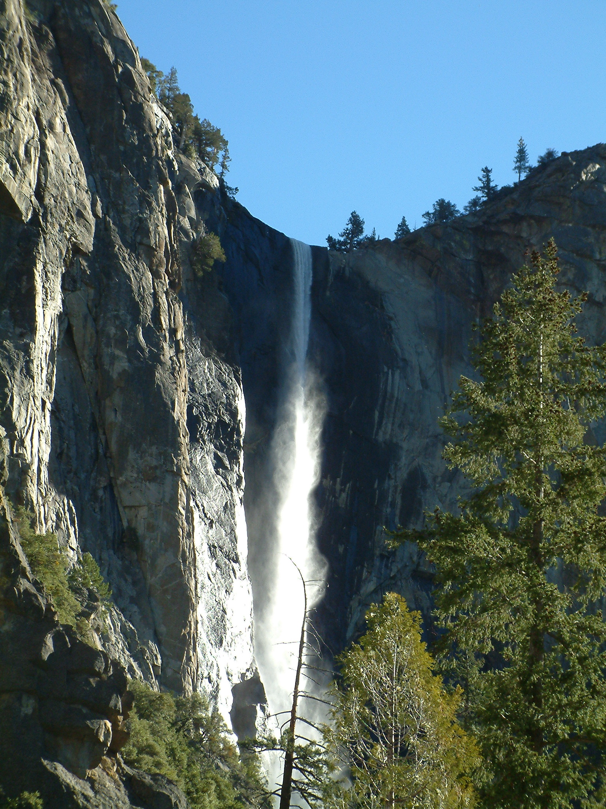
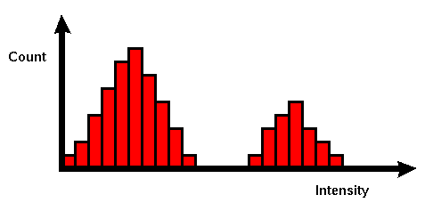
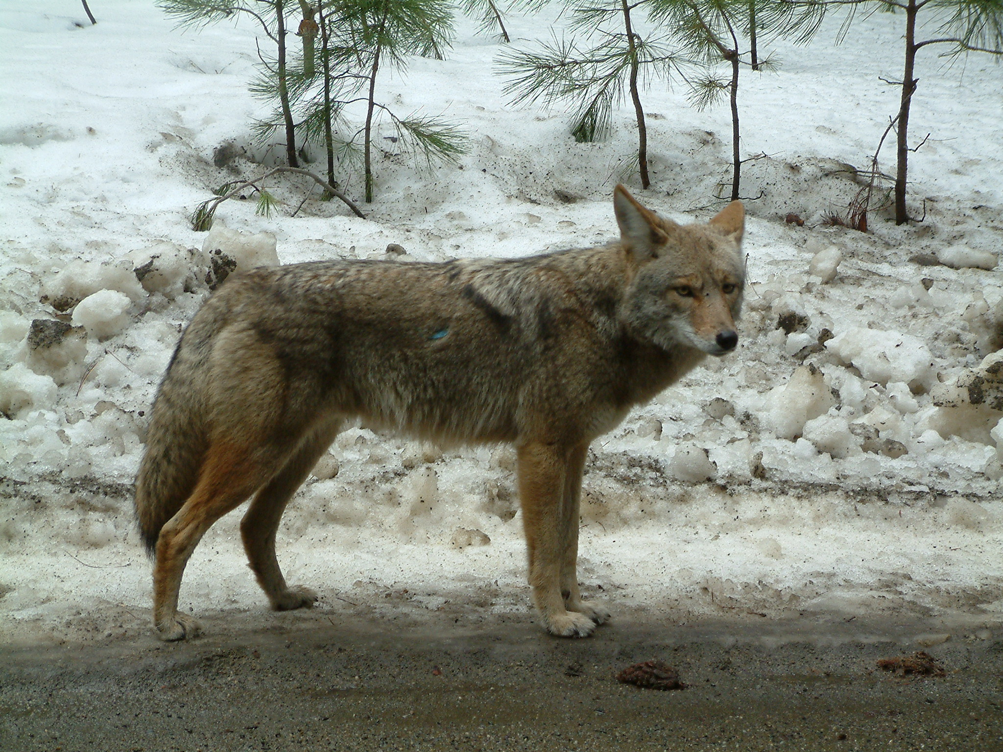
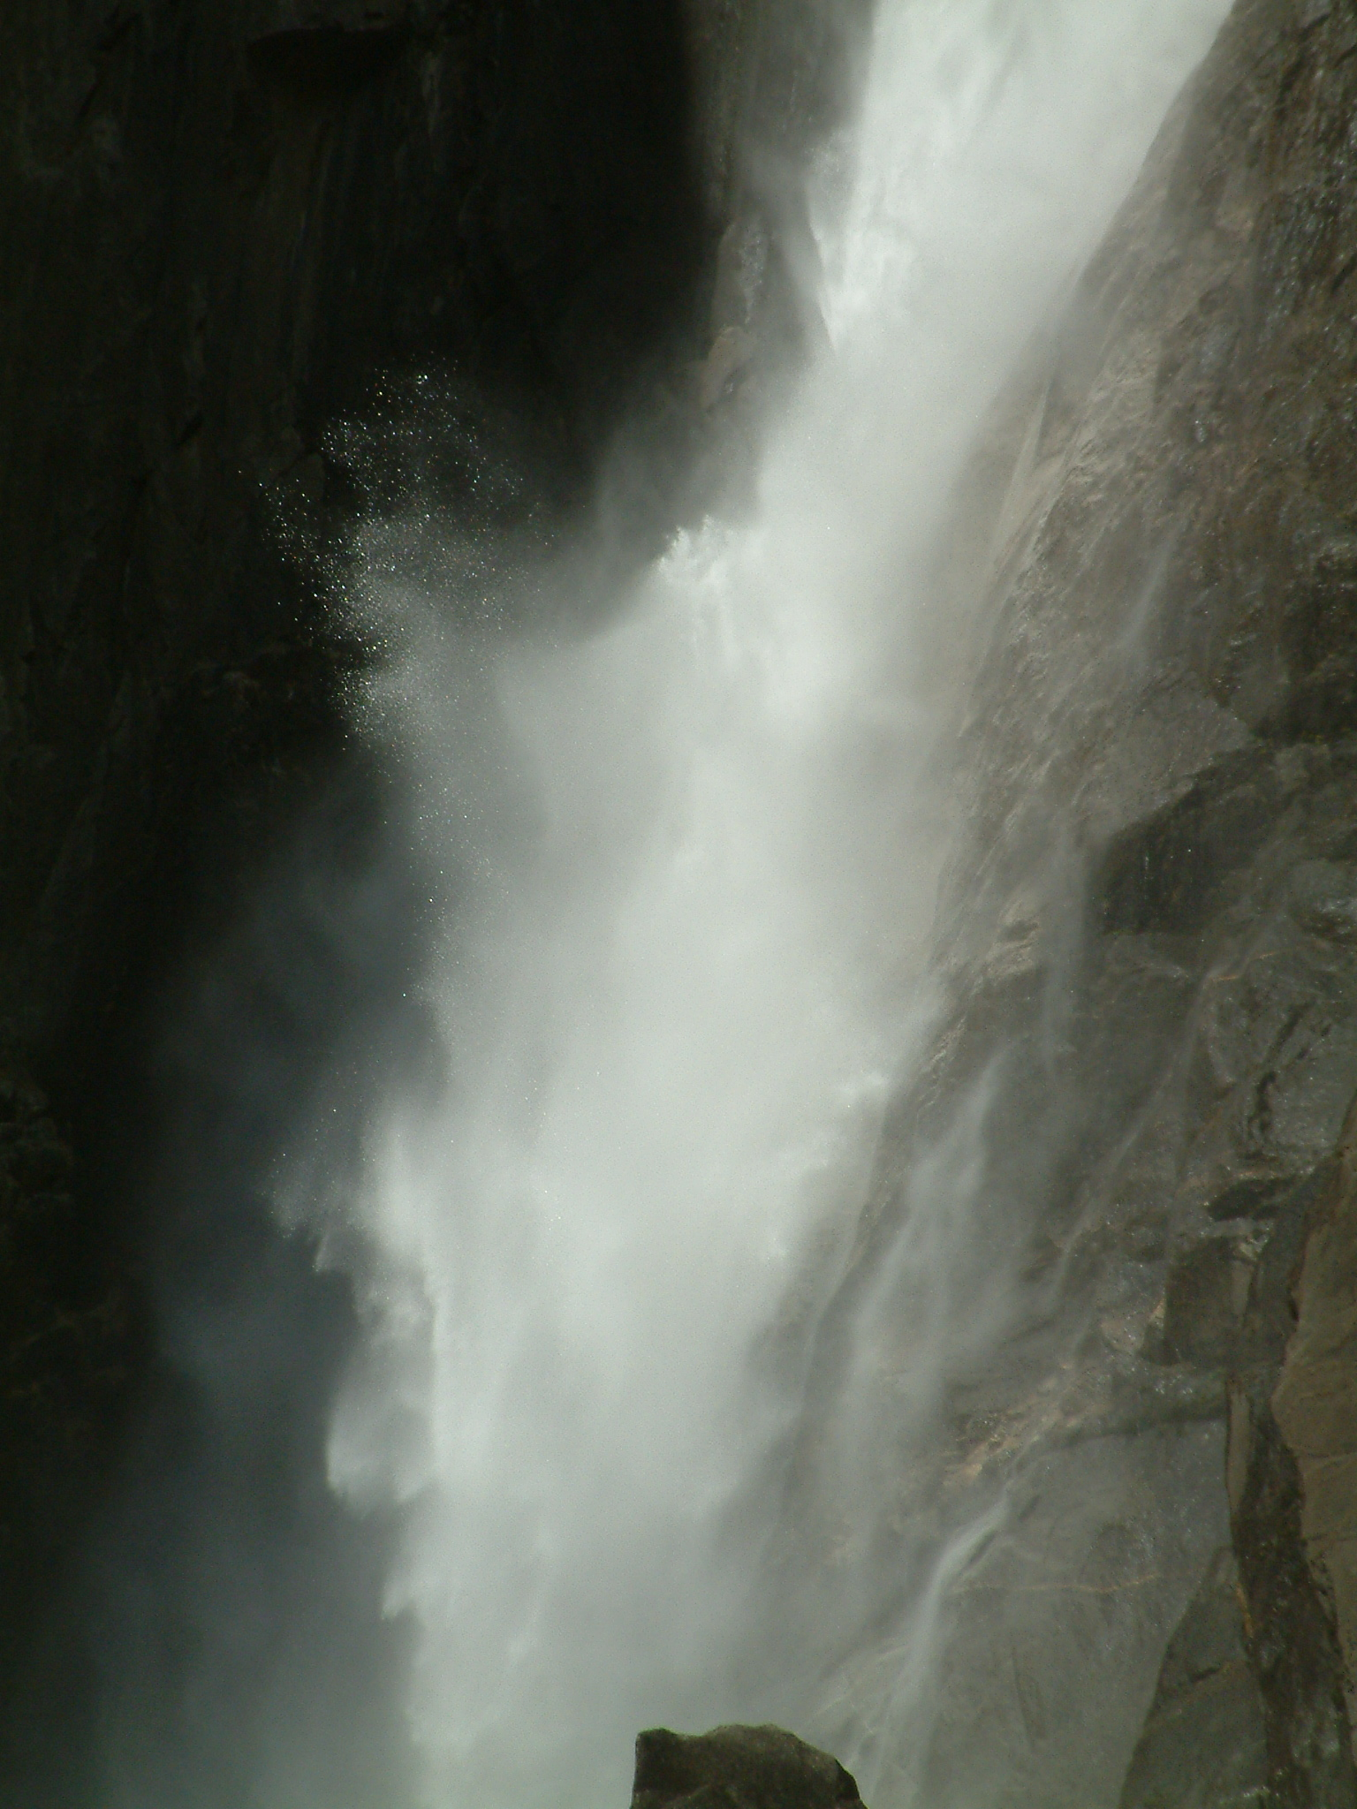
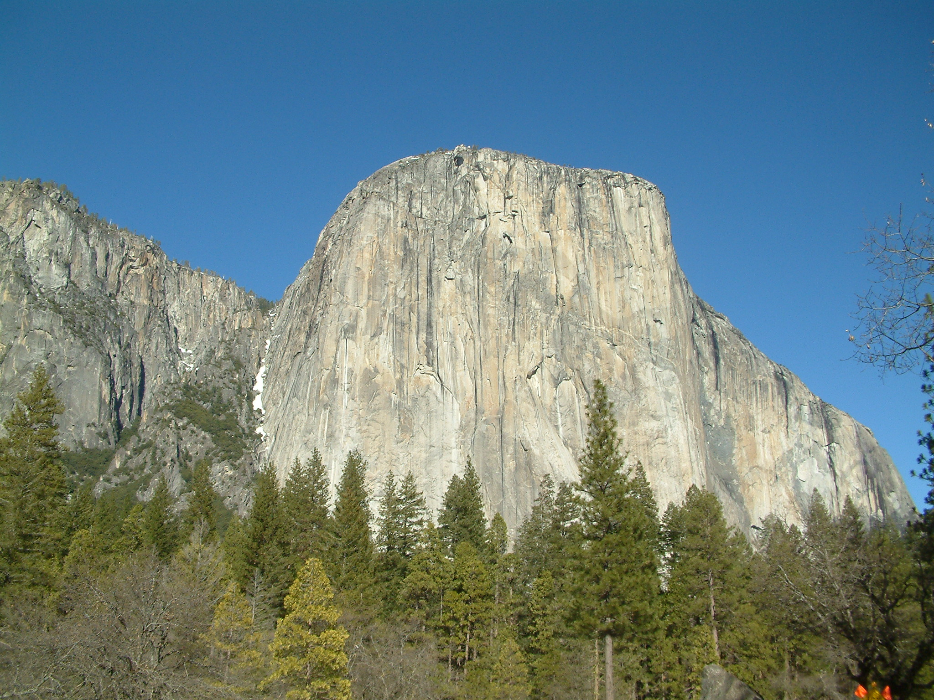
The Retrieval Pipeline
We extract a database of features from each media item in our corpus. To search we extract the same features from a query media item and compare its features to all of those extracted from the corpus.
Query
Search Engine
Result
Media Corpus
Database of features

Slide 21

Feature Extraction
f(x)
Feature extraction is the process of extracting “descriptors” from multimedia signals.
Descriptors describe some aspect of the media’s content.
Typically, a descriptor is a numerical vector called a “feature vector”, however other forms of descriptor are possible.

Slide 22
Example Image Features
colour histograms, segments and sift

Slide 23
Image Features: Global
Global features describe the content of an entire image
One of the simplest global features is the “Global RGB Colour Histogram”
Quantise each pixel into a discrete number of colours and then build a histogram.

Slide 24
Demo: Global Colour Features

Slide 25

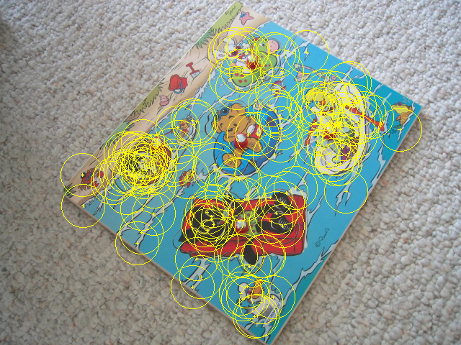
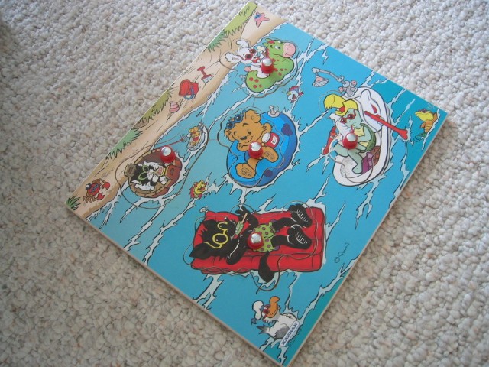
Image features: Local
Global features are useful for some tasks, but in many cases are not powerful enough
Local features attempt to overcome this by breaking the image into smaller parts from which to extract features
Three primary techniques for splitting up the image
segmentation
salient regions &
interest points
grids & blocks

Slide 26
Salient interest regions
Salient interest regions and their associated features are currently the most popular way of describing an image content.
Extracting image features using interest regions is a two-part process:
Find regions
Extract feature to describe region properties
Typically, the resultant image feature will have a variable length, dependent on the number of regions

Slide 27
Salient interest region Location
Important regions portray:
Repeatability
Saliency
Corners and blobs have these qualities
Detectable using various techniques
Difference of Gaussian - corners
Harris corner detector - corners
MSER - blobs
corners
blobs

Slide 28
Salient interest region descriptors
Good region descriptors portray:
Resilience to image transforms
Compactness
Emphasise different image characteristics:
Pixel intensities, colour, texture, edges etc.
Common descriptors include:
SIFT: histogram of edge orientation
Shape context: histogram of edge location

Slide 29
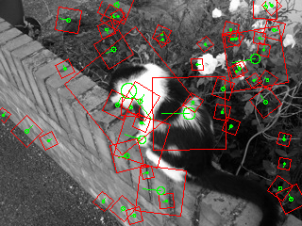
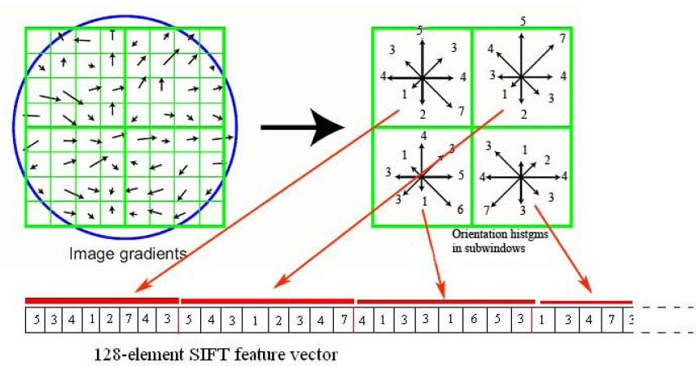
SIFT: Scale Invariant Feature Transform

Slide 30
Analogies with text
introducing the visual bag-of-words

Slide 31
Bags of Visual Words
In the computer vision community over recent years it has become popular to model the content of an image in a similar way to a “bag-of-terms” in textual document analysis.

Slide 32
BoVW using local features
Features localised by a robust region detector and described by a local descriptor such as SIFT.
A vocabulary of exemplar feature-vectors is learnt.
Traditionally through k-means clustering.
Local descriptors can then be quantised to discrete visual terms by finding the closest exemplar in the vocabulary.

Slide 33
Demo: SIFT Bag of Words

Slide 34
What about Video?
Simplest way to extract features from video is to treat each frame as a separate image.
There is a lot of redundancy
Can be better to find keyframes from each “shot”

Slide 35
Demo: Shot Keyframe Detection

Slide 36
What about Audio?
It turns out that one (good) way to extract features from audio is to transform it into an image first!
The image representation is a “spectrogram”
This is how Shazam works….

Slide 37
Demo: Audio Spectrogram

